Slide 1
Learning R in a classroom or online? A natural experiment
R without fear: teaching strategies to make R accessible to everyone
Sam Dumble: s.dumble@stats4sd.org
Statistics for Sustainable Development
RSS Conference– September 3rd 2024

Slide 2
Background
Statistician working for Statistics for Sustainable Development: www.stats4sd.org ; https://www.youtube.com/@Stats4SD
Pretty much everything I was taught about R at university seemed confusing, and I didn’t really understand what I was supposed to be doing with it.
Day 1 on my first ‘real’ job that I needed to write everything in R… have gone on to use pretty much nothing else for past 15 years.
Feel like everything useful I learnt about R came through practice, not through being taught. And that there must be a better way…

Slide 3

Who do I teach R to?
As a consultant – anyone! But for purpose of today’s talk focusing on one group:
“Introduction to R” for PhD students at the University of Reading.
Course administered through environmental sciences department but spaces open to any other PhD students to apply for
Run once per year for past 7 years
Huge diversity of existing skills, knowledge, interest levels
Generally: no programming experience; minimal stats knowledge from undergrad; encouraged to join the course by their supervisors rather than actively being interested.
Notes:
Two main groups I have worked with a lot – may be a quite different context to others working with “statistics students”.
(There are others – but these are the ones I will be referring back to and represent the vast majority of the work on training have done).
Lots of similarities in the two groups here, but also quite a lot of differences! Main similarity is the focus is on “learning R” rather than using R as part of learning (x/y/z). “New to R” + “not statistician, but needs to do stats”.
Other colleagues of mine have been involved in translating and modifying the original English materials I designed into Spanish and French. Given my horrific lack of language skills I will be focusing just on the English courses – so specifically in an East African context for CRFS and for the Reading phd cohorts.
With the Reading course in particular “Introduction to R” seems to attract a whole realm of different people – from those studying computer science and already very proficient at Python and Javascript, but had never used R before and wanted to know more, who generally find the content far too easy to bother with (I’m not worried about these people at all – they will be fine) to those who maybe did one course of statistics at undergraduate, didn’t really understand it, and hadn’t realized they had signed up for a course involving programming as they were hoping to find something easier to use than SPSS (I care a bit more about these people – we can at least help them onto a good path over a period of training). But mostly somewhere in the middle of those extremes!

Slide 4
The natural experiment?: Materials and methods
2014-2019
2020
2021-
Demand for intensive 3-5 day face to face workshops.
Hybrid Approach – making use of material produced online, but with ability to go back to classrooms
Lockdowns. All courses converted to online
We have ended up with something that looks like a natural experiment of the three different modalities. Nearly all other variables being held constant:
the course content
the institution & general profile of the students
the teachers
And we even have a lovely range of mixed methods data sources we could use:
course feedback forms
attendance stats
course representative reports back to university administrators

Slide 5
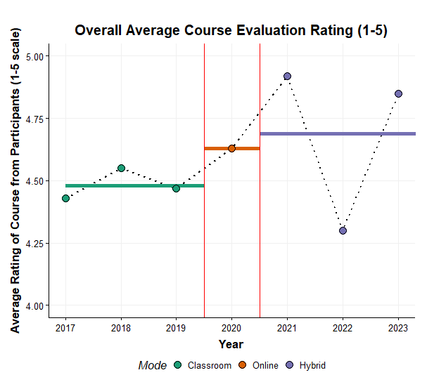
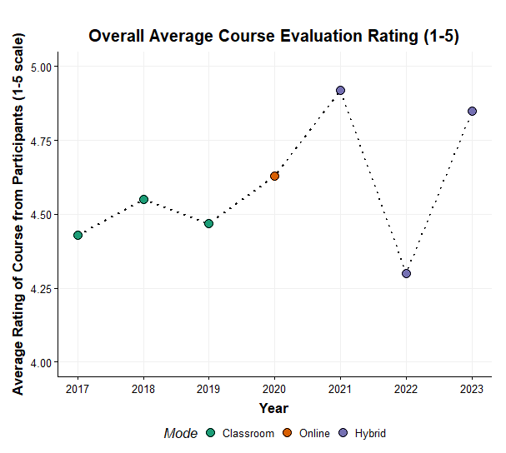
Results:
2 out of 3 ain’t bad…
2022 & 2023 had a slightly different ‘hybrid’ model to 2021, which was not a sustainable model.
For 2023 we learnt from, and adapted, some of the things that did not work so well in 2022.
…this is not really intended to be interpreted as a ‘serious’ experiment. Instead – some reflections on what seems to work and what doesn’t

Slide 6
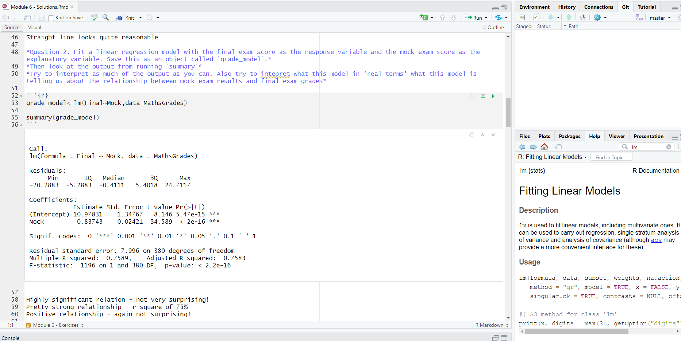
Teaching “Introduction to R” means introductions to a lot more than just “R”
Better work out what I need to do to my own data to make sure I can import
I can get results out of R formatted into nice reports as well? Interesting…
Got to save my working with comments in a reproduceable way. But .R or .RMD or .QMD or …?
Version control sounds like a good idea? How does that work?
Maybe I need to manage my files and use projects?
What’s the deal with all the extra installation of packages?
Some R code- but why do I need to create an object of my lm..?
Lots of numbers here – what do they all mean? I didn’t really pay attention in stats class
This help wasn’t that helpful. Where do I get some actual help on linear regression?
OK – I worked it out! Better make sure to add comments
Notes:
For students to be able to actual go on and use R effectively they need to know a lot more than just the mechanics of how R code is constructed.
For us this window looks very familiar. For someone never used Rstudio before this is a lot - huge cognitive overload!
…
Not to mention how spending the first session of a course installing R and Rstudio is a very frustrating way to have an introduction. In a group of 30 students you can guarantee some will have issues with installation and others won’t which will lead to a long boring time for a lot of people and a frustrating complicated time for other people as we try and work out why they are facing issues.
This is why we love learnR workbooks as the mechanism by which we teach the first few modules of our courses. We put the data, the context and the code as the initial starting points. We also can go off on slight tangents where teaching about graphs first – yes people are learning about the ggplot components but it also serves as a subtle reminder of different types of plot, and good practice for laying out and labelling plots. As an initial topic this is more familiar and more interesting to students than data structures as they will all know at least some of it already, and can see how it applies to their own work immediately. Over time we can slowly introduce the other concepts and by the end of the course everyone will be using Rstudio and recognizing why they should be using Rstudio.
We also put the focus on the data first – and trying to wrangle interesting and fun findings out of the data through emphasising ggplot, dplyr, data importing, and then Rstudio orientation as the core tools in the first part of the course.– the students won’t care about object types and writing functions and Bayes factors until they understand why they might be useful. Let’s learn one thing at a time and put the focus on the code itself up front

Slide 7
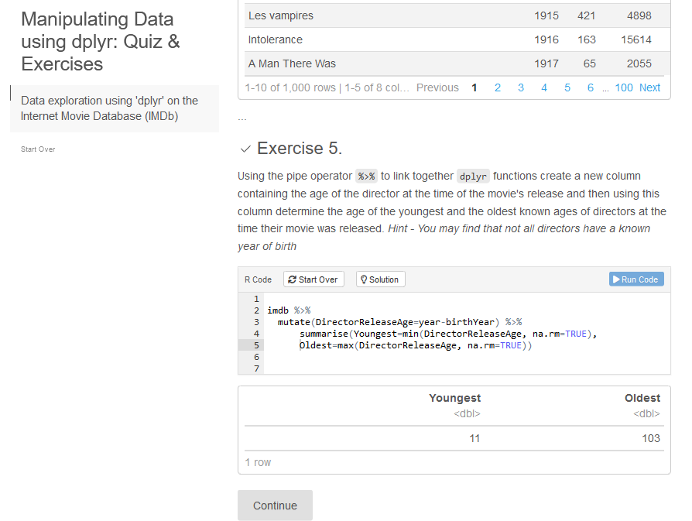

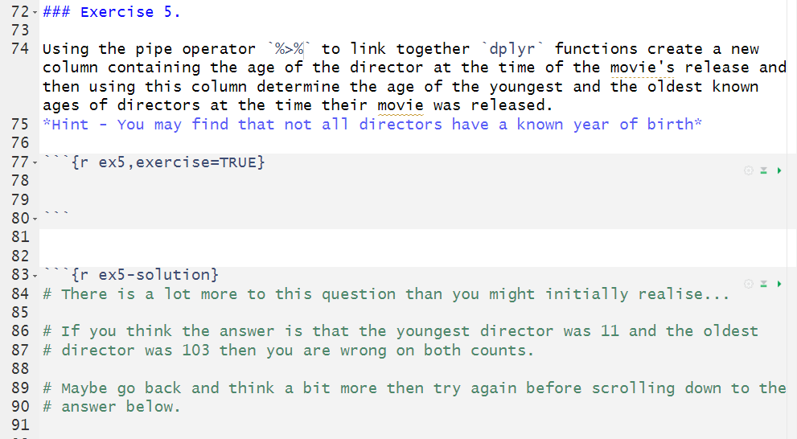
learnR – helping to teach the code first
https://github.com/stats4sd/dplyr_learnr
https://shiny.stats4sd.org/dplyr_learnr__live/
Notes:
Separating the code from the software at the start turns out to be a huge help – regardless of the modality.
In person sessions would generally take a long frustrating time to be able to get started as either everything could only be able to be demonstrated and not followed, or a large amount of time would be sent on managing installations and weird issues for installing packages to be used etc. It’s not a nice introduction to the world of R.
Starting the course with admin means you are losing before you have started!
learnR makes it really easy to create interactive tutorials that can be hosted online – it is 99% just a normal markdown file with a few extra bits to build the interactivity. So students are able to interact only with the code and we don’t have to worry about setting up scripts, and projects and data files and packages until later on in the course when hopefully they are already interested and are starting to see the point.
And – at the end of the course they get the same tutorials they were working through online in the RMD format that they are now familiar with – as good examples of coherently scripted analysis that they can work through and adapt from
We only adopted using the tutorials because of the shift online – but we still continue to use them when training in person as the interface for totally new users works so much better for them.

Slide 8
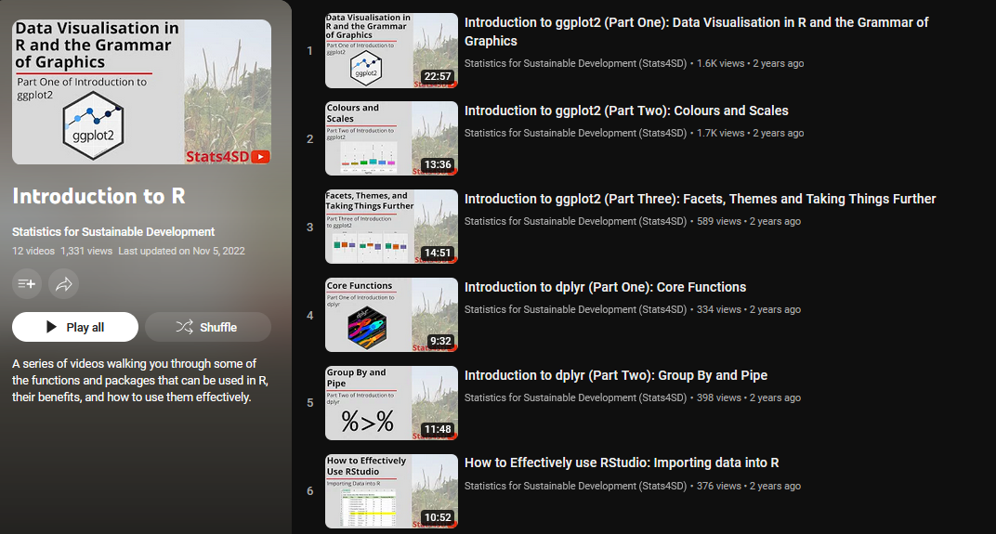
Some things work better online…
https://www.youtube.com/playlist?list=PLK5PktXR1tmM_ISpxwoiXD2SioG3MWNqg
Notes:
For ‘lectures’ or code demonstrations we found these pretty much universally worked better and were better received on video than they had been when equivalent content was done live in the room
It gave us the ability to make sure we :
Stuck to the key points (without tangents arising from fun questions, or unintentional mistakes in code demos) on schedule and covered everything we needed to without running short on time or rushing through
Could edit to ensure we could highlight the code/make sure the code was visible
Share script files alongside the videos directly so people could follow along
Students are now well used to watching video lectures and seem to like being able to re-watch particular parts/ or watch on double speed
Reduces scheduling conflicts for ability to follow most of the course at their own pace on their own schedule.
Pre-recording the videos enabled us to try to bring in ‘performative’ aspects to the material not just blindly ploughing through facts. The small tangents or interesting contextual points are really important to try to make sure things stick in people’s minds. A slightly off metaphor will stick in people’s minds in a way that a dryer (or correcter) explanation will not – as long as they can connect that to the point you were making then you are onto a winner. This is more of a challenge when language comes into play though. It’s easier to hit these notes in a pre-record rather than going live where you can miss them or miss the mark if you are trying out something new

Slide 9
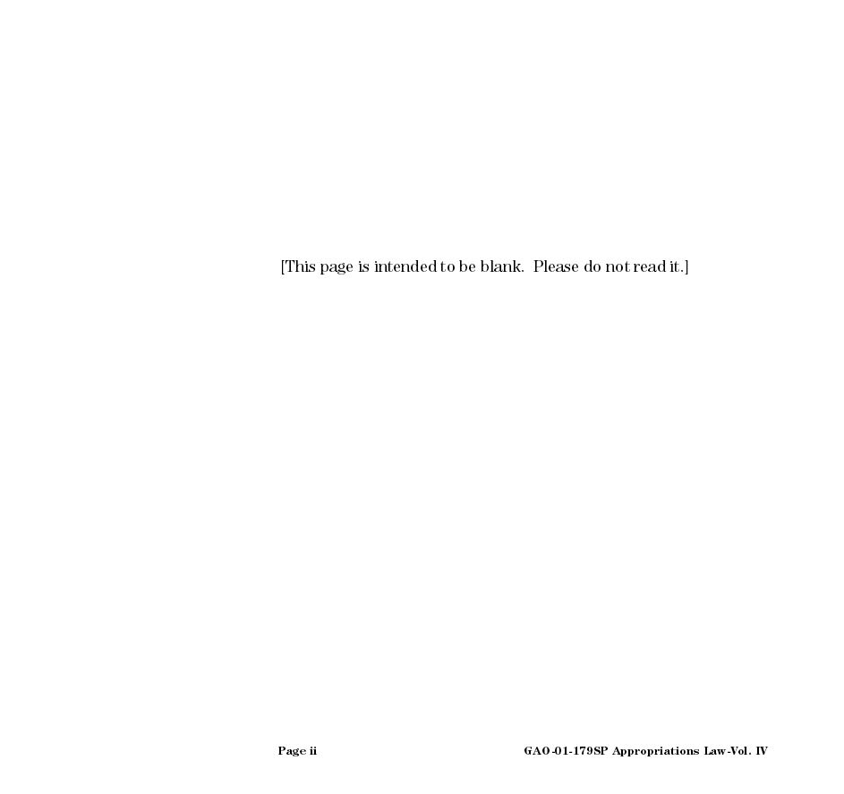
…‘nothings’ worked better off line
Notes:
With a very mixed ability group you generally have to aim towards the lower-middle of the room Those people who were most engaged with the course were those we were pitching material for at the right level in the middle of the ability range. And they were the ones who were more willing to engage in the online replacements for 1-1 interactions. People at the lower ability end often struggled to articulate what the error was online, and it was usually something that could be understood and then explained immediately when seeing what they were doing. And people at the higher ability end of the range drifted away from the course before asking more complex (and interesting!) questions that would always come during breaks/after the end of workshop sessions.
Something which is very hard to show online is “workflows” as pure text/video demos of this can quickly get a bit confusing or jargon filled and however many times you suggest people follow along live maybe 10-20% actually do. learnR removes these barriers by putting the focus only on code but that adds a new barrier for when the participants want to head out to analyse data in the real world.
So our in person workshops look, on the surface, to be totally unscheduled sessions going through exercises. But this is giving a chance where people will follow along and see the workflow in reality and help us identify those at the very bottom catch up and get them the one-on-one time they need to make progress.
It also lets there be time for interactions at the top-end of the room to cover the more advanced end of questions or talk about their own research problems in R, to make sure those people are also feeling like they are learning something from the course as well. The best discussions often happen in the breaks – so our unscheduled time also includes a long break in the middle and we also try and schedule it to be at the end of the day so keen people can stick around and keep asking questions.
This was the main thing we found we could not replicate online whichever method we tried to facilitate less formal online interactions. And there was those who really struggled with the jump from the learnR workbooks to using Rstudio – so for the middle of the course we allowed both routes to be possible for completing exercises. But we were determined to get everyone out of the comfort blanket of learnR and into a real working environment as best as we could.

Slide 10
Some challenges are specific to the classroom…
Having ‘one size fits all’ material and strictly enforced timetables.
‘Lecture time’ can be very easily derailed by the top of the ability range asking interesting, but out of scope questions, which can lose the “middle” of the room
‘Workshop time’ is can be taken up supporting the bottom 5% - struggling to navigate through File Explorer or making obvious typos in code. This limited capacity to support the questions from the “middle of the room”, and faster learners tended to finish exercises quickly and get bored.
Notes:
More difficult to embed extension material for those working quickly, or to provide extra space for those struggling

Slide 11
… and some challenges specific online
A lot of the ‘bread and butter’ day 1 of learning code issues were just not being raised online. In the classroom there is no hiding from us seeing errors, and then being able to provide support immediately to talk through their challenges.
Generally any questions have a delayed response – a challenge when trying to gain the initial momentum for learning a brand new topic
When students dropped out they tended to just vanish… and became hard to follow up for why they vanished
Notes:
There are a lot more barriers to get people to proactively raise those issues in online learning environment. Lots of options tried out, but nothing close to replacing the personal 1-1 conversation.
Spreading the course over a longer period was good for those at least moderately engaged but became more of a burden on those who didn’t buy in from the start

Slide 12
Conclusions
For faster learners / or those with more relevant experience the ‘online-only’ version seemed to work better – able to explore and learn more topics at their own pace, whilst still having guidance from the instructors.
For slower learners / without any experience – the classroom version seems to work better – as there is instant support to get over the frustrating parts of the learning curve, and less extension material to confuse things
But the hybrid model does seem to be able to give the best of both worlds, particularly for the majority of students in the middle of this cohort. The lockdown in 2020 forced our hand, but has ultimately resulted in a better final product
Every year I learn something new when prepping and delivering these courses!

Slide 13
Prepared for: RSS Conference 2024
Created and presented by:
Sam Dumble: s.dumble@stats4sd.org
September 2024

Slide 14
Links, references & resources
Tutorial demo from presentation: https://github.com/stats4sd/dplyr_learnr
https://shiny.stats4sd.org/dplyr_learnr__live/
Teach the Tidyverse (Garret Grolemund, RStudio) | https://github.com/rstudio-education/teach-the-tidyverse
LearnR, Interactive Tutorials for R (RStudio) | https://rstudio.github.io/learnr/
Using learnr to create interactive tutorials for R (and RStudio): from the pinnacle to the pit (Andy Field, University of Sussex) | https://www.youtube.com/watch?v=8h_PAFlp5a0
Learning R: University vs. the Workplace (Alex Thomson, Stats4SD) | https://stats4sd.org/blog/53
Stats4SD Introduction to R Video Playlist | https://www.youtube.com/@Stats4SD https://www.youtube.com/playlist?list=PLK5PktXR1tmM_ISpxwoiXD2SioG3MWNqg

